Slide 1

Project C
Mattia Siriani - 10571322

Slide 2



Chapters
Trace fitting
JMT Simulation
Results

Slide 3

Fittings
Fittings of the different traces on different CDF (Cumulative Distribution Functions)

Slide 4
Fittings - Description
In the following pages will be present two graphs for each trace given.
The graphs on the left contains the traces with the following distribution functions:
Uniform
Exponential
Hypo-exponential
Hyper-exponential
Erlang
Gamma
The graphs on the right contains the traces with the best fitting among the distributions used.
If multiple distributions fits the simpler is chosen.
First example: in Test all distribution, except for Uniform, fits the given Trace, for that reason the exponential distribution function was chosen.
Second example: in Specification and Design, both the Erlang and the Gamma fits, but since the Erlang is a special case of the Gamma, where the stage parameter is an integer, the Erlang distribution was chosen.

Slide 5
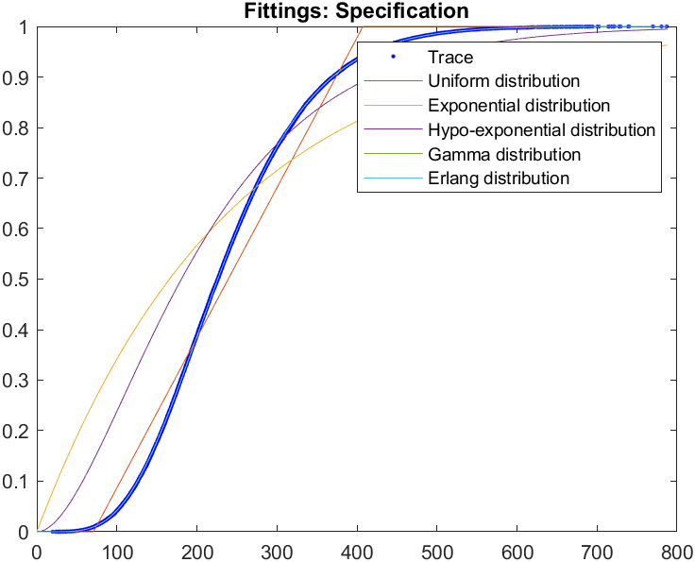
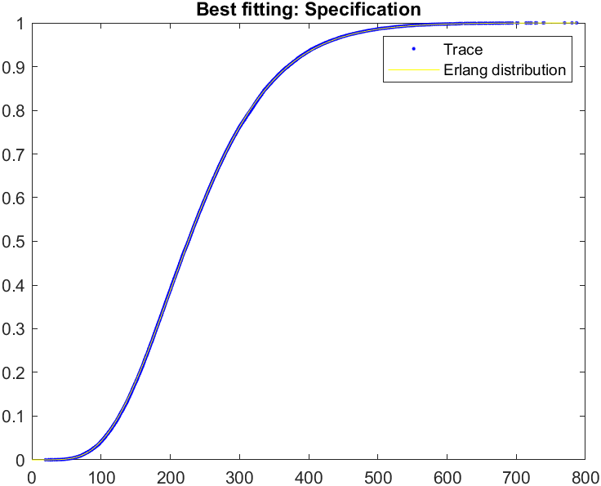
Fittings - Specification

Slide 6
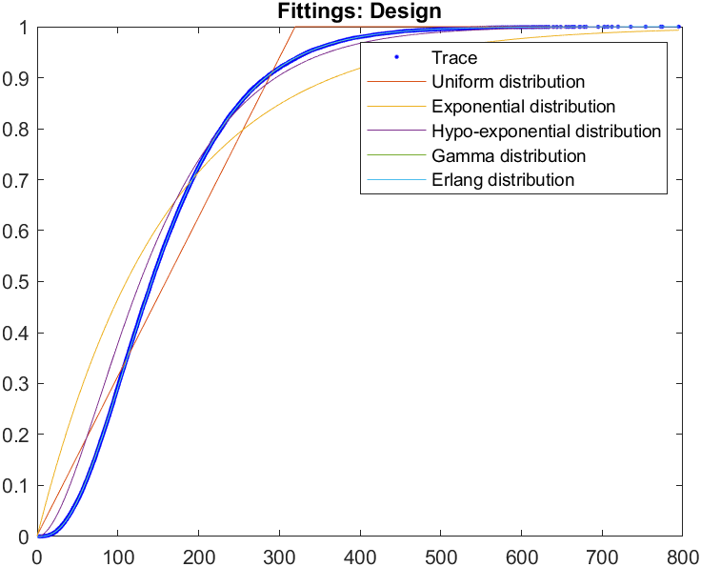
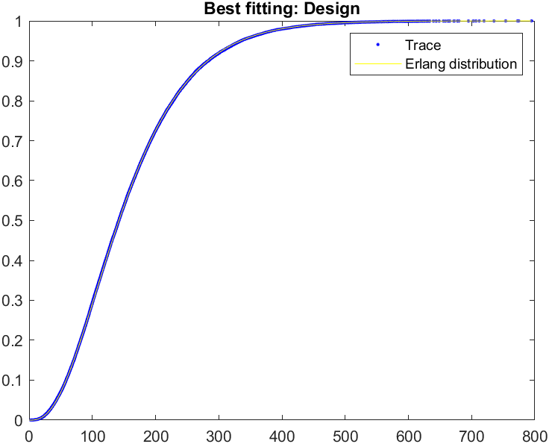
Fittings - Design

Slide 7
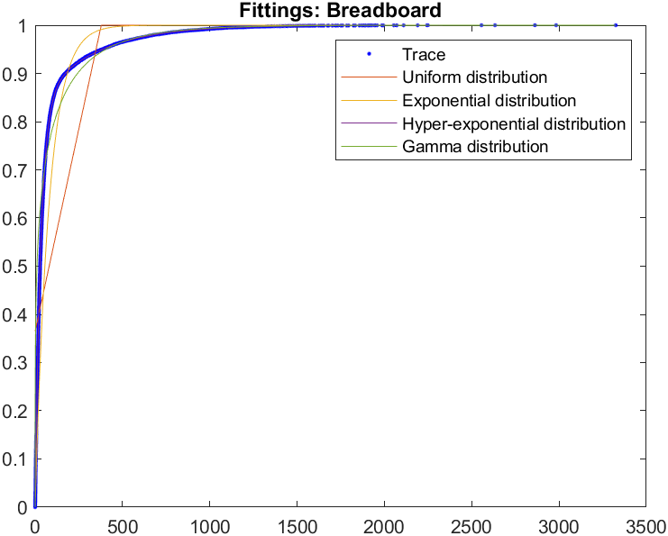
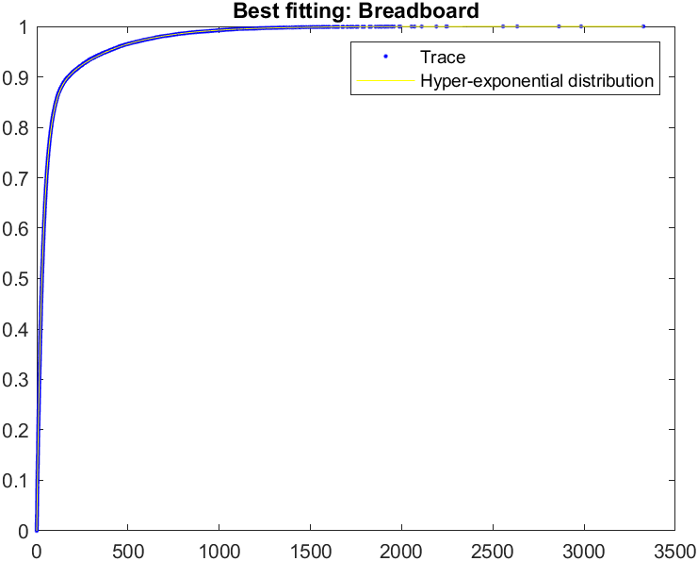
Fittings - Breadboard

Slide 8
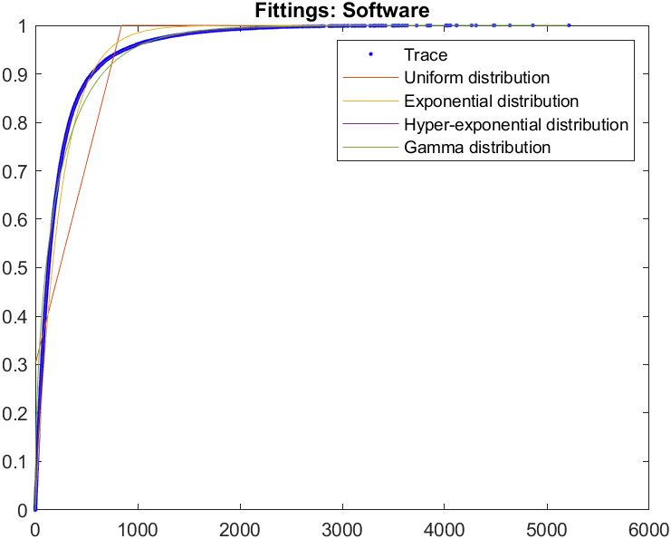
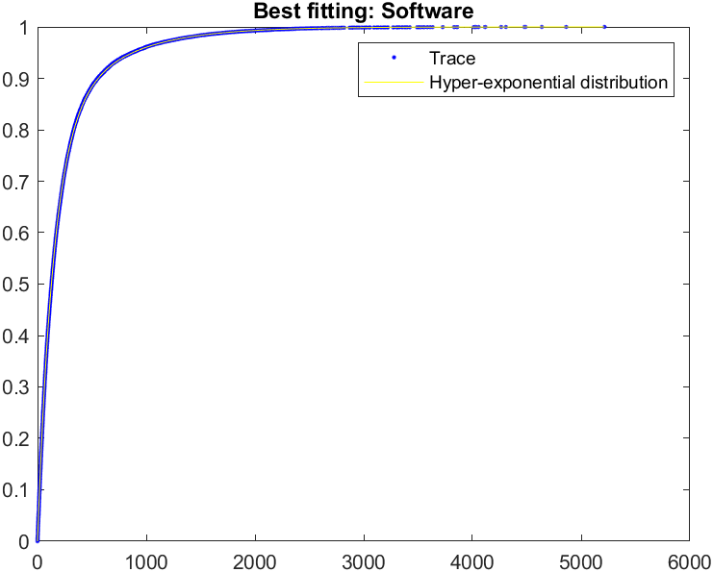
Fittings - Software

Slide 9
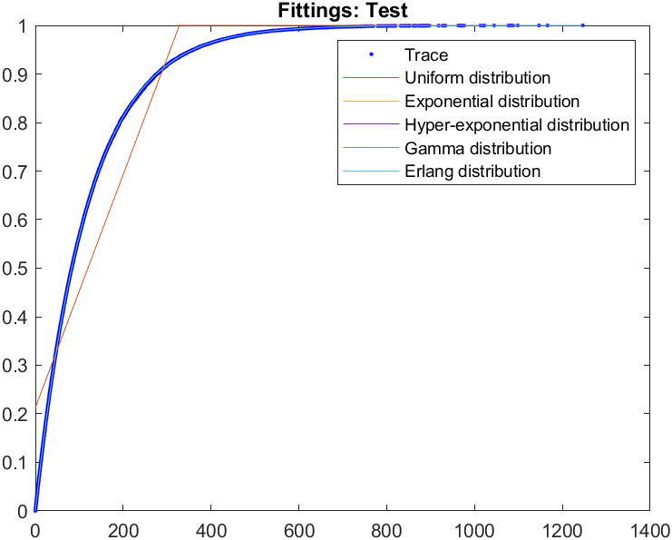
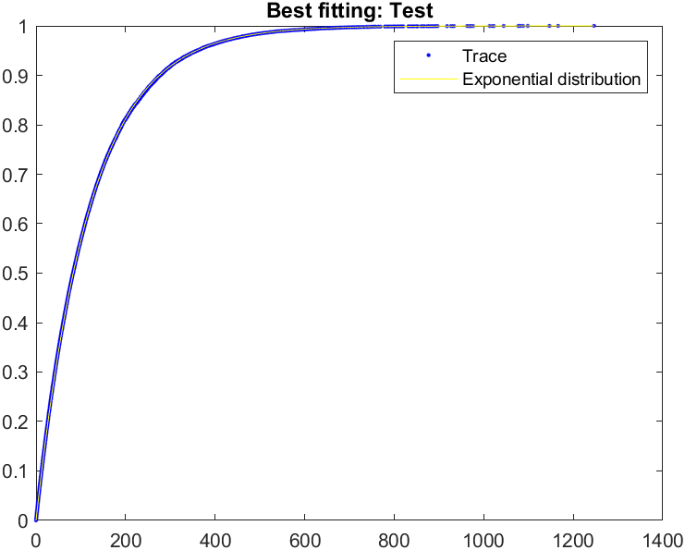
Fittings - Test

Slide 10

JMT Simulation
Simulation of the proposed problem.

Slide 11
JMT Simulation - Description
The simulation has been performed in the following way:
5 different station to define the different departments, with their correspondent Service Time distribution.
Fork/join nodes used to wait before the Test department can start working on the job.
Since the model is a batch system no delay node is needed, so there is no need to wait at the end of the Test department.
The reference station is set on Specification, since it is where the development cycle starts.
Only one class, representing the projects, has being used.
Use of What-if Analysis on the number of projects from 1 to 20, to analyze the performance indices for different number of N.

Slide 12
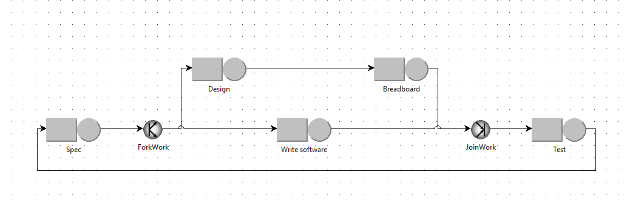
JMT Simulation - JSIMgraph

Slide 13
Results
Results obtained by the simulation.

Slide 14
Results - Description
The following results were obtained by a JMT simulation, with a confidence interval of 0.99.
From the following results we can see that the best tradeoff between throughput and project completion time is obtained when N is equal to 3 (also 2 gives good results but lower than 3 in mean). With N equals to 3, we can see that the confidence intervals are the same, but the mean value is slightly higher.
Since the results with N equals to 2 and 3 was nearly the same, I have computed the simulation different times and the overall maximum tradeoff was N equals to 3.
Tradeoff \ N | 1 | 2 | 3 | 4 | 5
Mean Value | 1.92E-6 | 2.54E-6 | 2.55E-6 | 2.36E-6 | 2.18E-6
Max confidence interval | 1.95E-6 | 2.62E-6 | 2.62E-6 | 2.43E-6 | 2.24E-6
Min confidence interval | 1.90E-6 | 2.47E-6 | 2.47E-6 | 2.30E-6 | 2.12E-6

Slide 15
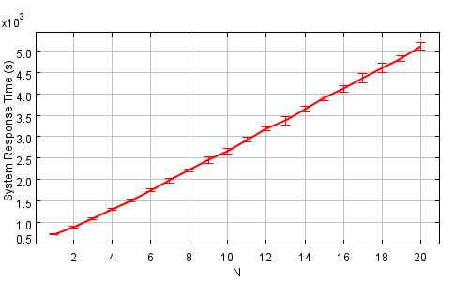
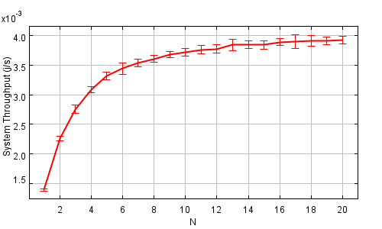
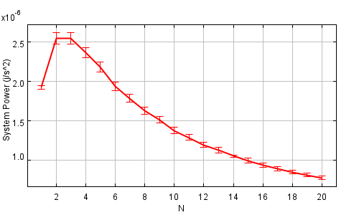
Results – Some graphs
The response times keep increasing as the number of projects increase, so more time is always required.
The throughput start to increasing slowly as the value of N increases, because for higher values of N, the network is fulfilled.
Therefore, the tradeoff between response time and throughput is higher for lower value of N.
The correct unit of measure of the above graph is $\left(h\right)$
The correct unit of measure of the above graph is $\left(\frac{j}{h}\right)$
The correct unit of measure of the above graph is $\left(\frac{j}{h^{2}}\right)$

Slide 16
Results - Bottleneck
N = 2 | Spec | Design | Breadboard | Software | Test
Mean value | 0.5394 | 0.3602 | 0.1799 | 0.5467 | 0.2722
Max Conf. Int. | 0.5476 | 0.3670 | 0.1853 | 0.5564 | 0.2784
Min Conf. Int. | 0.5313 | 0.3534 | 0.1746 | 0.5369 | 0.2660
The following tables define the utilization of all the departments (with a Confidence Intervals of 0.99), for the value N with the higher tradeoff and its neighbors.
From the tables we can see that the bottleneck are on the software and the specification departments (more software than specification, according to the corresponding confidence intervals and to the value of the neighbors' results).
N = 3 | Spec | Design | Breadboard | Software | Test
Mean value | 0.6597 | 0.4376 | 0.2195 | 0.6583 | 0.3291
Max Conf. Int. | 0.6721 | 0.4486 | 0.2239 | 0.6777 | 0.3371
Min Conf. Int. | 0.6472 | 0.4266 | 0.2151 | 0.6389 | 0.3211
N = 4 | Spec | Design | Breadboard | Software | Test
Mean value | 0.7412 | 0.4919 | 0.2445 | 0.7476 | 0.3747
Max Conf. Int. | 0.7527 | 0.4993 | 0.2489 | 0.7627 | 0.3847
Min Conf. Int. | 0.7298 | 0.4845 | 0.2402 | 0.7325 | 0.3647

